Slide 1
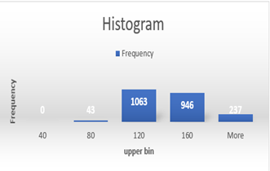
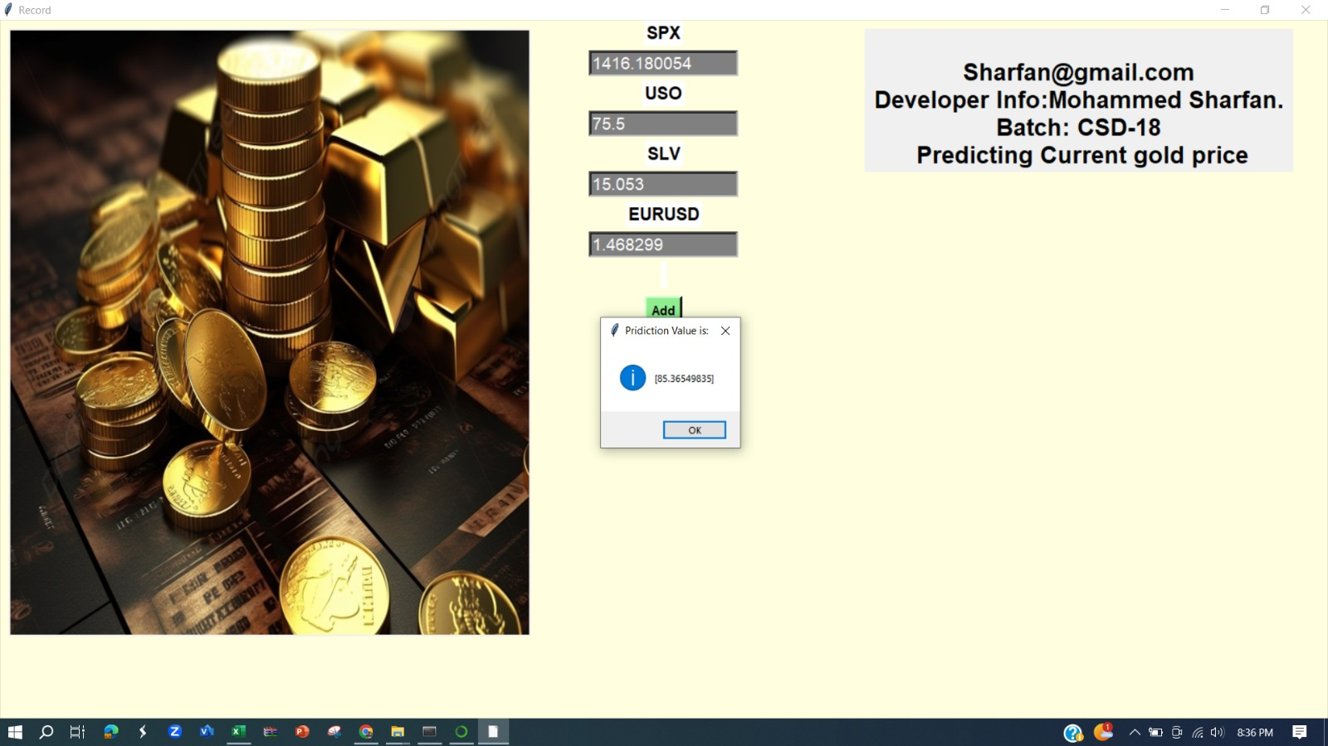
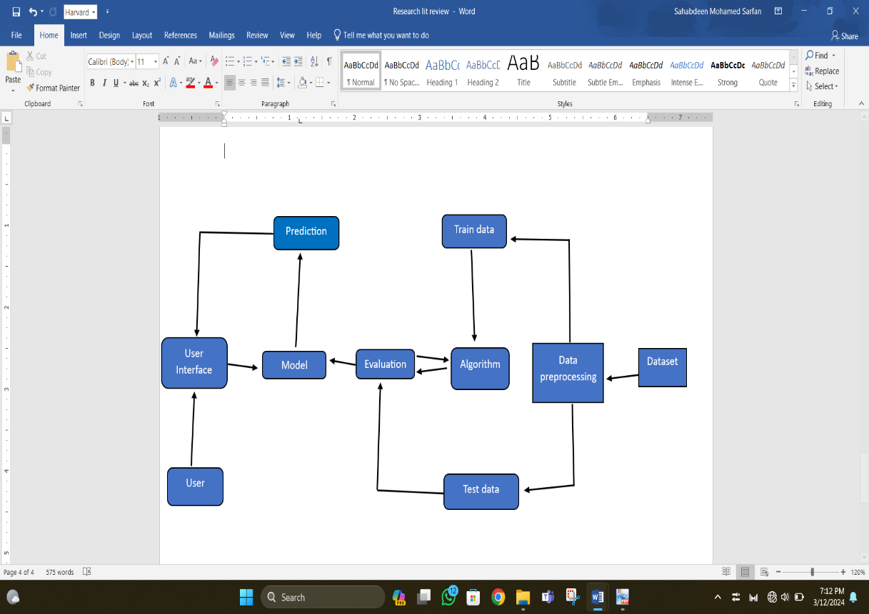
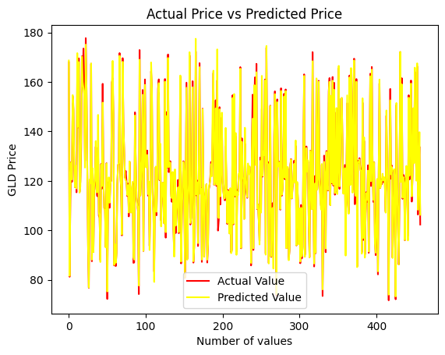
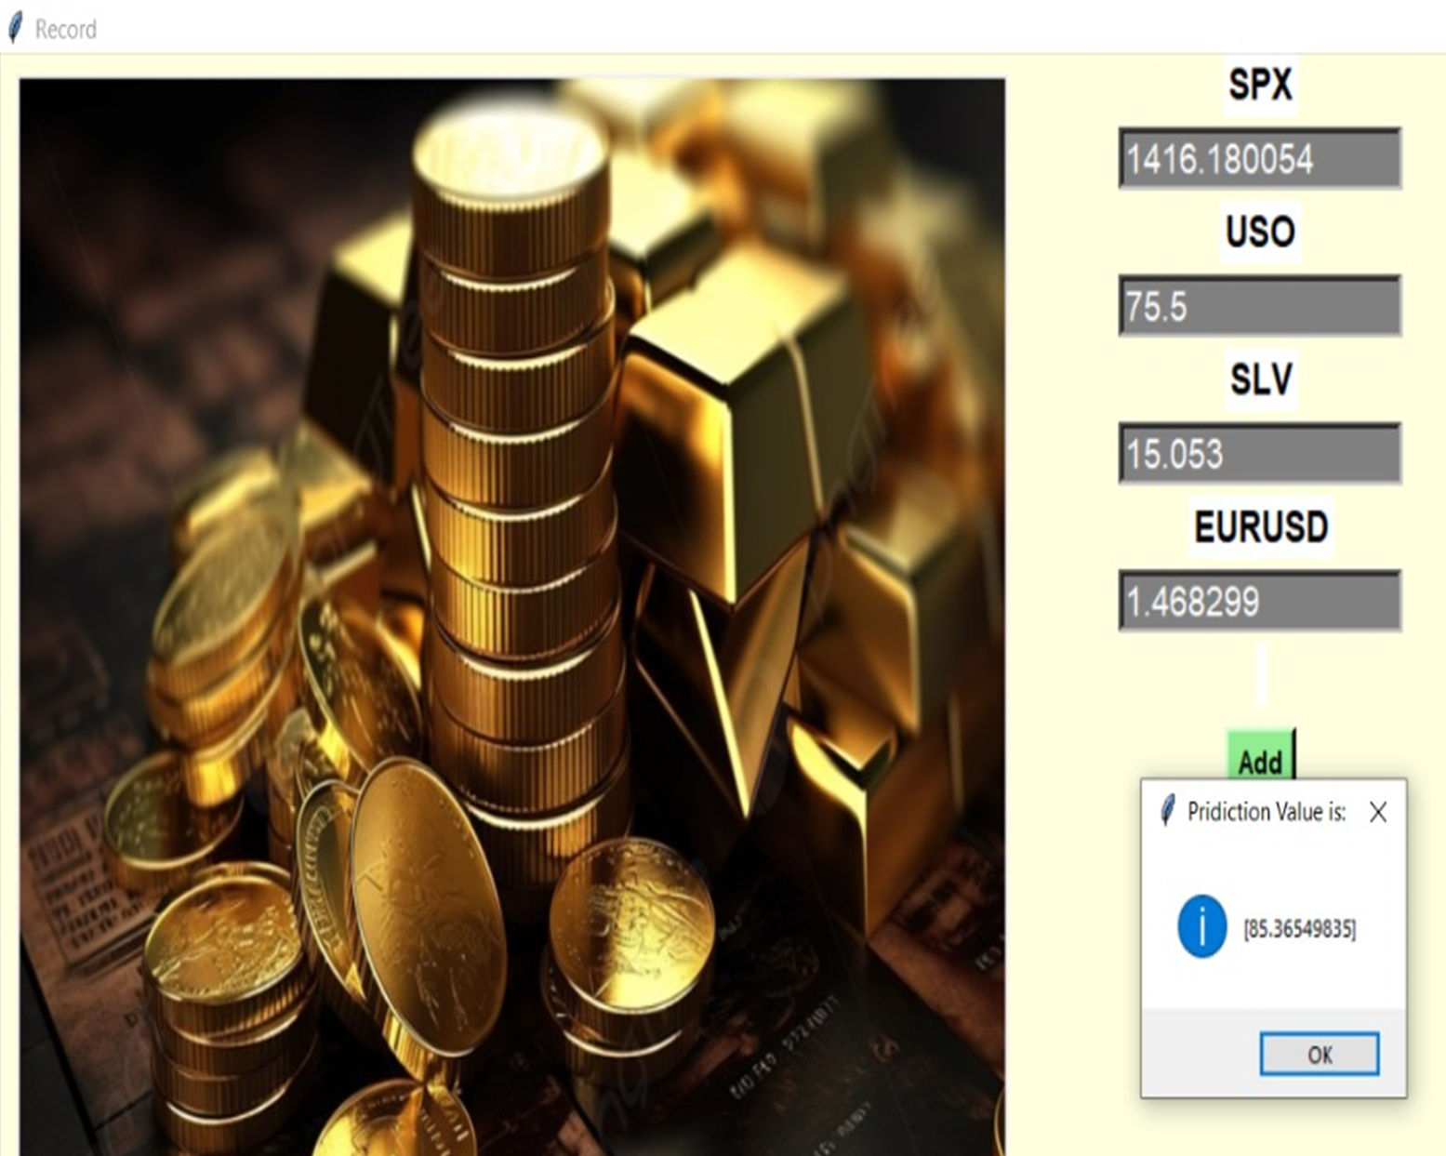
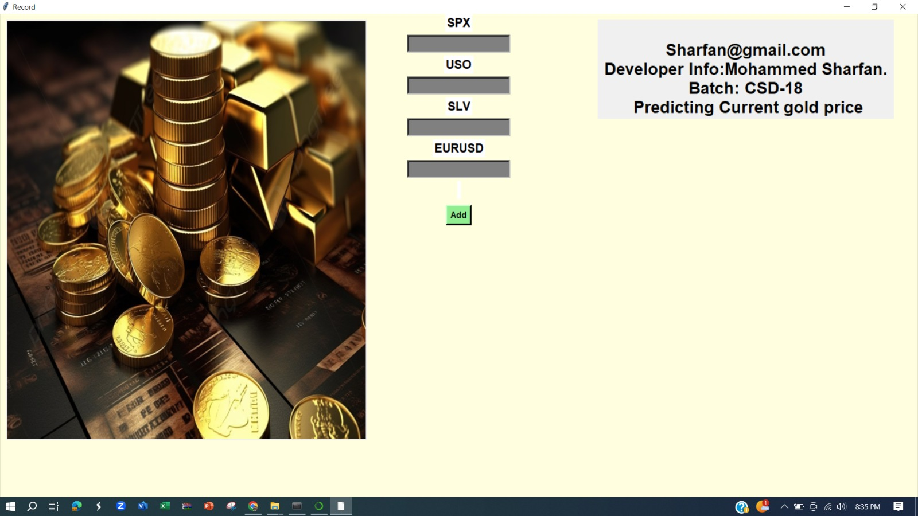
Big Data Analysis for Gold Price Prediction.
S. Mohamed Sarfan
British College of Applied Studies
School of Computing.
Abstract
According to the project's goal, the user interface seen above allows users to check the price of gold as of right now. But the provided dataset is used to train this model. As a result, the model is operating properly in accordance with the dataset. with a 98% accuracy.
Results
Historically, in addition to other forms of payment, gold was utilized to fund international commercial operations. A number of states were acknowledged as prosperous and forward-thinking while preserving and increasing their gold stockpiles. These days, the central banks of every nation hold precious metals like gold to ensure that foreign loans are paid back and to rein in inflation. Additionally, it illustrates the nation's financial stability. Governmental organizations are not the only people and international corporations that have made investments in gold reserves. Gold is also given as presents or mementos during traditional Asian celebrations, and in India, Pakistan, and other Asian nations, gold ornaments are given as dowers at weddings. Gold rates are heavily influenced by the performance of the world's top economies in addition to supply and demand for the commodity on the market. We use machine learning techniques to estimate future gold pricing based on 05 (SPX, USO, EUR/USD, SLV, GLD) market indicators. The findings indicate that we can fairly precisely forecast the daily gold rates. Our forecasting tools will help central banks and investors make informed decisions about whether to purchase this commodity.
Results may vary from each GLD value. Expected results is Current gold price. This results are found based on various categories like SLV, USO, EUR/USD, SPX value.
Methods
The term "method" describes the start-from-scratch project design and procedure. The relevant dataset is first gathered and stored in CSV format. It is handled in a manner that both trains and tests the data. Data that has been tested and trained is in algorithm a format. These algorithms are assessed and trained to create a model that allows the user to enter numbers and forecast whether the price of gold is now higher or lower.
Conclusion
"Through our research, we've demonstrated the importance of incorporating various economic factors into gold price prediction models. Utilizing the random forest machine learning method, we've achieved more accurate forecasts. By considering stock market performance, silver price, EUR/USD, and US oil exchange-traded funds, our model provides valuable insights for investors and businesses in navigating the dynamics of the gold market."
Objectives
Our project, centered on big data analysis for gold price prediction, has three primary objectives. Firstly, we aim to meticulously uncover the fundamental factors influencing gold prices. Next, we strive to construct sophisticated predictive models capable of forecasting future gold prices accurately. Lastly, our endeavor involves continual refinement of these models to enhance prediction accuracy over time. Join us in unraveling the complexities of gold price dynamics and pioneering advancements in predictive analytics.
I have carefully planned my project using this specific methodology. Preprocessed training data is used to train the model. The model's parameters must be optimized and fitted to the data in order to achieve this. Approximately 80% of the dataset has been presorted for training. The trained model is evaluated on an alternative test set. About twenty percent of the data in the dataset are separated out for testing. This allows us to assess how well the model generalizes to new data. The train data is evaluated using an algorithm. The test data is evaluated, and the processed data is put into the model. The model receives data that the user enters. Following data analysis, the model produces a prediction. A response providing the prediction is sent to the user. The forecasts are based on the properties of the incoming data and the relationships between those properties and the target variable.
The above image you sent is a graph comparing the actual price of an asset, likely gold (GLD), with its predicted price. This system predict 98% accurately predict correct gold price.
Discussion
Our study highlights the significance of incorporating economic indicators like stock market performance, silver price, EUR/USD, and US oil exchange-traded funds to enhance gold price predictions.
Utilizing the random forest model, we observed improved accuracy in forecasting gold prices, showcasing the efficacy of machine learning in financial forecasting.
By considering supply-demand dynamics and geopolitical events, our model offers insights into the complex interplay of factors influencing gold prices.
Accurate gold price predictions are essential for central banks and investors, enabling informed decision-making and risk management in the global market.
Bellow the histogram telling , which has a little positive skew, the majority of gold prices fall within a particular range. This indicates that prices at the lower end of the range occur more frequently than those at the higher end. It's hard to say for sure without knowing the precise range on the x-axis, but the histogram probably shows that there haven't been any significant swings in gold prices throughout the observed time.

